Slide 1
Interclass and intraclass measures

Slide 2
Introduction
Need of measures for evaluation and validation of
Segmentation
Classification
This can be done
By visual inspection
Interclass and intraclass variability measures

Slide 3
Classification: True vs. False and Positive vs. Negative
Let's make the following definitions:
"Wolf" is a positive class.
"No wolf" is a negative class.
We can summarize our "wolf-prediction" model using a 2x2 confusion matrix that depicts all four possible outcomes:

Slide 4
Classification evaluation
A true positive is an outcome where the model correctly predicts the positive class.
Similarly, a true negative is an outcome where the model correctly predicts the negative class.
A false positive is an outcome where the model incorrectly predicts the positive class.
And a false negative is an outcome where the model incorrectly predicts the negative class.

Slide 5
Classification measure
Accuracy
Sensitivity
Specificity
Precision

Slide 6
Accuracy
Accuracy is one metric for evaluating classification models.
Informally, accuracy is the fraction of predictions our model got right.
Formally, accuracy has the following definition:
Accuracy=Number of correct predictions/Total number of predictions
For binary classification, accuracy can also be calculated in terms of positives and negatives as follows:
Accuracy=TP+TN/TP+TN+FP+FN
Where TP = True Positives, TN = True Negatives, FP = False Positives, and FN = False Negatives.

Slide 7
Accuracy example
Let's try calculating accuracy for the following model that classified 100 tumors as malignant (the positive class) or benign (the negative class):
True Positive (TP):Reality: Malignant ML model predicted: Malignant Number of TP results: 1 | False Positive (FP):Reality: Benign ML model predicted: Malignant Number of FP results: 1
False Negative (FN):Reality: Malignant ML model predicted: Benign Number of FN results: 8 | True Negative (TN):Reality: Benign ML model predicted: Benign Number of TN results: 90

Slide 8
Accuracy example
Accuracy=TP+TN/TP+TN+FP+FN
Accuracy = 1+90/1+90+1+8 = 0.91
Accuracy comes out to 0.91, or 91%
(91 correct predictions out of 100 total examples).
Limitation: Accuracy alone doesn't tell the full story when you're working with a class-imbalanced data set, where there is a significant disparity between the number of positive and negative labels.

Slide 9
Precision
Precision attempts to answer the following question:
What proportion of positive identifications was actually correct?
Precision is defined as follows:
Precision=TP/TP+FP

Slide 10
Precision example
True Positives (TPs): 1 | False Positives (FPs): 1
False Negatives (FNs): 8 | True Negatives (TNs): 90
The precision for tumor classifier:
TP/TP+FP = 1/1+1 = 0.5
Our model has a precision of 0.5—in other words,
when it predicts a tumor is malignant, it is correct 50% of the time.

Slide 11
Sensitivity or Recall
Sensitivity or Recall attempts to answer the following question:
What proportion of actual positives was identified correctly?
Sensitivity/Recall refers to the ability to correctly detect the specific condition
Mathematically, recall is defined as follows:
Sensitivity or Recall=TP/TP+FN

Slide 12
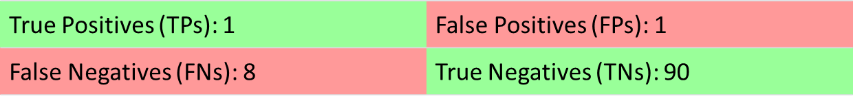
Sensitivity/Recall example
The recall for tumor classifier:
Recall=TP/TP+FN = 1/1+8 = 0.11
Our model has a recall of 0.11—in other words, it correctly identifies 11% of all malignant tumors.
Sensitivity is also known as True Positive Rate

Slide 13
Precision and Recall: A Tug of War
To fully evaluate the effectiveness of a model, you must examine both precision and recall.
Unfortunately, precision and recall are often in tension.
That is, improving precision typically reduces recall and vice versa.

Slide 14
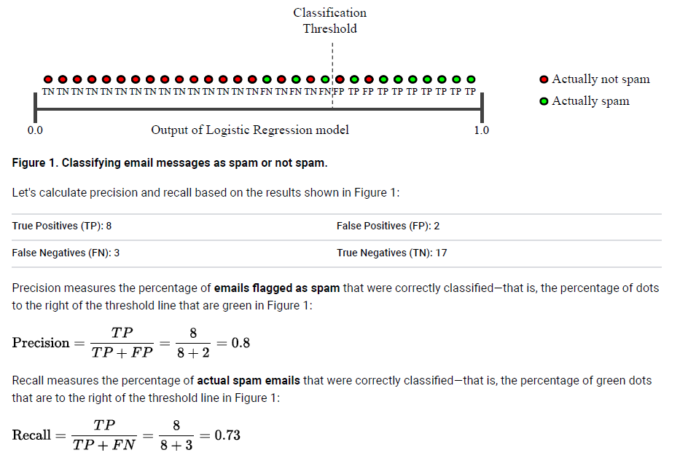
Example

Slide 15
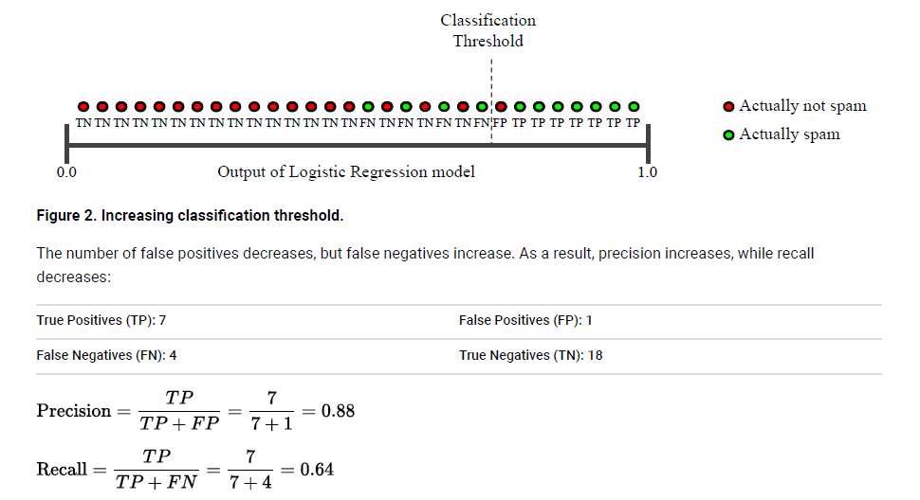
Effect of increasing the classification threshold

Slide 16
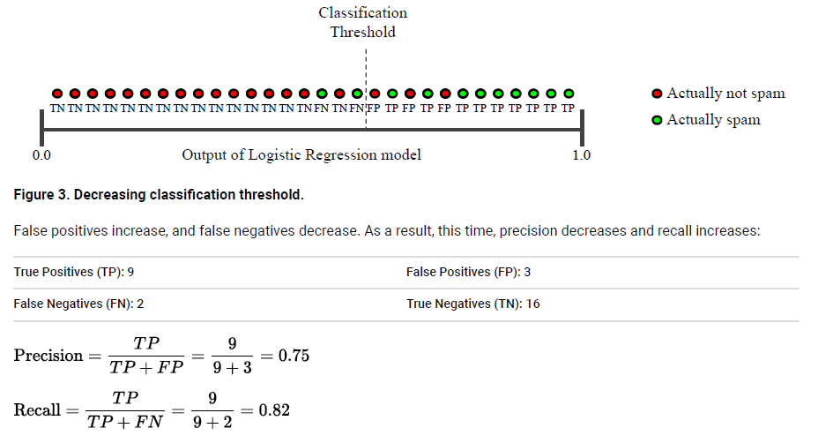
Effect the decreasing the classification threshold from position 1 in Fig.1

Slide 17
Specificity
Specificity relates to the ability to correctly detect not to have the condition, in this case no tumor
Specificity = TN/TN+FP

Slide 18
ROC Curve
An ROC curve (receiver operating characteristic curve) is a graph showing the performance of a classification model at all classification thresholds.
This curve plots two parameters:
True Positive Rate
False Positive Rate

Slide 19
ROC Curve
True Positive Rate (TPR) is a synonym for recall and is therefore defined as follows:
TPR=TP/TP+FN
False Positive Rate (FPR) is defined as follows:
FPR=FP/FP+TN

Slide 20
ROC Curve
An ROC curve plots TPR vs. FPR at different classification thresholds.
Lowering the classification threshold classifies more items as positive, thus increasing both False Positives and True Positives.
The following figure shows a typical ROC curve.

Slide 21
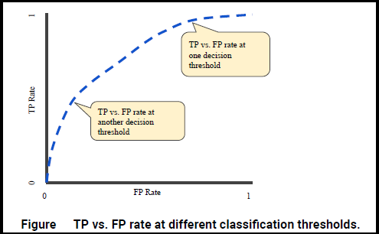
ROC Curve

Slide 22
ROC Curve
To compute the points in an ROC curve, we could evaluate a logistic regression model many times with different classification thresholds, but this would be inefficient.
Fortunately, there's an efficient, sorting-based algorithm that can provide this information for us, called AUC.

Slide 23
Area Under Curve (AUC)
AUC stands for "Area under the ROC Curve." That is, AUC measures the entire two-dimensional area underneath the entire ROC curve (think integral calculus) from (0,0) to (1,1).

Slide 24
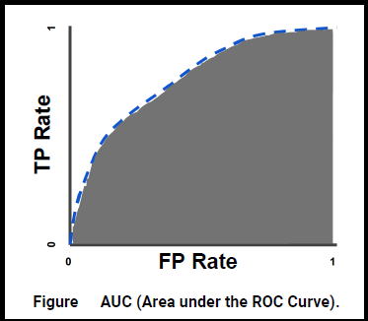
AUC

Slide 25
AUC
AUC provides an aggregate measure of performance across all possible classification thresholds
One way of interpreting AUC is as the probability that the model ranks a random positive example more highly than a random negative example

Slide 26
Prediction Bias
Logistic regression predictions should be unbiased.
That is: "average of predictions" should ≈ "average of observations "Prediction bias is a quantity that measures how far apart those two averages are
That is:
prediction bias=average of predictions−average of labels in data set

